Slide 1
Geometry - Planes
Programming – Maths for Games

Slide 2
Contents
Definition
Plane vs Point Test
Plane vs Circle Test
Plane vs Box Test
Plane vs Ray Intersection Test
Plane vs Plane Intersections

Slide 3
Definition
A Plane is a geometric object that separates space into two regions
In front of the plane
Behind the plane
In 2D it can be thought of as an infinite line that separates the 2D space
In 3D it is an infinite surface splitting the same
Typically used to define boundaries and used for various queries
Is an object in front of the plane?
For example, testing for offside in a football match
Is an object behind the plane?
For example, is an object behind the view of the camera?
Front Region
Plane
Back Region

Slide 4
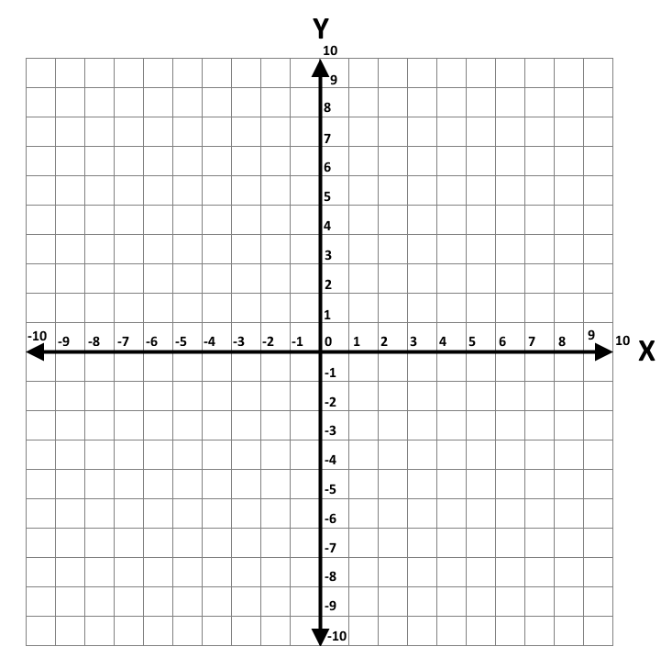








Definition
A Plane is represented by the notation
In 2D: $ax+by+d=0$
In 3D: $ax+by+cz+d=0$
We typically store a Plane as
A normalised Normal Vector $N$ defining the facing of the Plane
A negative Scalar offset $d$ from the origin of the coordinate space
$Plane=(N,d)$
We can calculate the Scalar offset for a Plane given a Point on the plane and a Normal
Using the Normal of the Plane we perform a Dot Product against a point on the Plane and negate the result
$$P$$
$$N$$
$$−d$$
struct Plane2D {
Vector2 n;
float d;
}
$$ax+by+d=0$$
$$N_{x}P_{x}+N_{y}P_{y}+d=0$$
$$N_{x}P_{x}+N_{y}P_{y}=−d$$
$$−(N_{x}P_{x}+N_{y}P_{y})=d$$

Slide 5





Definition
We can also calculate a 3D plane given just 3 Points
Using points $P_{0}$, $P_{1}$ and $P_{2}$
Calculate:
$V_{0}=P_{1}−P_{0}$
$V_{1}=P_{2}−P_{0}$
The Plane Normal is then a Cross Product between $V_{0}$ and $V_{1}$:
$N=V_{0}×V_{1}$
The Scalar offset is then a Dot Product between the Normal and any of the original Points:
$d=−N∙P_{0}$
$$P_{2}$$
$$N$$
$$P_{0}$$
$$P_{1}$$

Slide 6

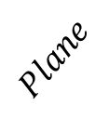






Plane vs Point Test
$$P_{1}$$
One of the most useful geometric tests we can do with a Plane is determining which side a Point is on
We simply:
Perform a Dot Product between the Point and the Plane’s Normal
Add the Plane’s $d$ value to the result
If the result is positive then the point is in front of the plane
If the result is negative then the point is behind the plane
If the result is 0 then the point is on the plane
Also called coplanar
$$d=negative$$
$$Plane$$
$$P_{0}$$
$$N$$
$$P_{0}∙N+d=negative=back$$
$$P_{1}∙N+d=positive=front$$

Slide 7







Plane vs Circle Test
Another useful test is comparing a Circle or Sphere with a Plane
We start by performing the Plane vs Point test with the Circle’s centre
If the result is greater than the Circle’s radius the circle is fully in front of the plane
If the result is less than the negative of the Circle’s radius then the circle is fully behind the plane
Otherwise the Circle is touching the plane
$$radius$$
$$centre$$
$$N$$
$$centre∙N+d=t$$
$$t>radius=front$$
$$t<−radius=back$$
$$abs\left(t\right)≤radius=overlap$$

Slide 8
Plane vs Box Test
We can also test an Axis-Aligned Bounding Box or Oriented Bounding Box with a Plane, though the rest is trickier
There are various ways to implement
One method is:
Find the distance between the Box’s centre against the Plane
Compare the result against Dot Products for each of the Box’s half-extents against the Plane’s normal
Another method for AABB is:
Find the minimum and maximum extents of the box in the direction of the normal via the Box’s min and max corners
Compare the extents against the Plane’s d to check for overlap
A brute-force method is simply to test each corner point of the Box against the Plane

Slide 9
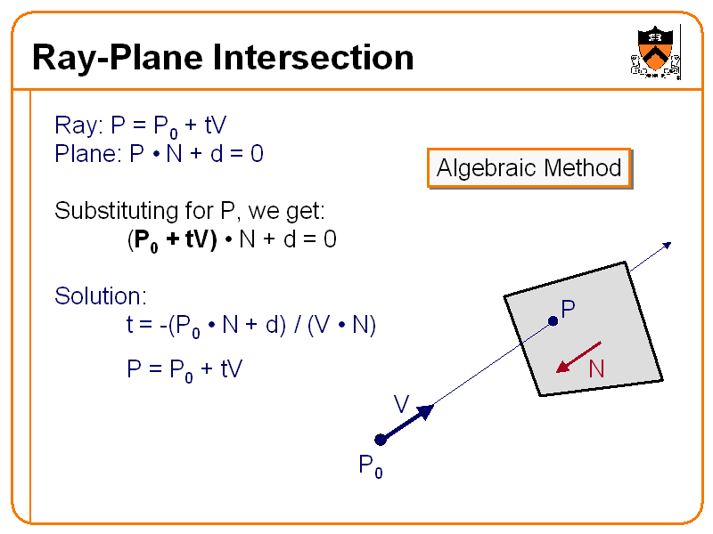

Plane vs Ray Intersection Test
Testing a Ray against a Plane to find a point of intersection has many uses
Projectiles
Picking locations on a map
Typically only done if the Ray is facing the Plane
Where V is the Ray’s normalised direction vector:
$$−\left(N∙V\right)>0$$
To find the intersection point $P$we define:
$P=P_{o}+tV$
Where $P_{o}$ is the Ray’s origin point
$V$ is the Ray’s normalised direction vector
$t$ is the distance in the direction of V from $P_{o}$ to the intersection point $P$
First we need to calculate what $t$ is

Slide 10



Plane vs Ray Intersection Test
We begin by:
Dot Product the Ray’s origin with the Plane’s normal and add the Plane’s $d$ and negate the result
Dot Product the Ray’s direction vector with the Plane’s normal
Divide the first value by the second value to find $t$
We can then find the intersection point $P$ by completing the equation
If the Ray is finite then the Ray intersects the Plane only if $t$ is less than or equal to the Ray’s length
$$t=−(P_{o}∙N+d)/(V∙N)$$
$$P=P_{o}+tV$$

Slide 11
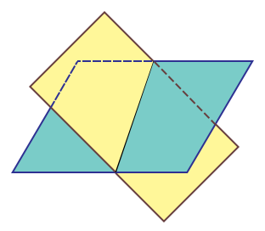
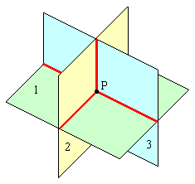

Plane vs Plane Intersections
It is possible to intersect multiple planes
2 intersecting planes in 2D forms a point
2 intersecting planes in 3D forms a line
Less common
3 intersecting planes in 3D forms a point
Useful for certain corner techniques
The following is a method for calculating the intersection point of 3 planes in 3D:
$$P=\frac{−d_{1}\left(N_{2}×N_{3}\right)−d_{2}\left(N_{3}×N_{1}\right)−d_{3}(N_{1}×N_{2})}{(N_{1}×N_{2})∙N_{3}}$$

Slide 12
Summary
Planes are an important geometric tool in games and simulations
Used to separate spaces and define boundaries
Can be tested with various other geometric shapes to classify them
Front
Back
Coplanar

Slide 13
Further Reading
Dunn, F, Parberry, I, 2011, 3D Math Primer For Graphics And Game Development, 2nd Edition, CRC Press
Lengyel, E, 2012, Mathematics for 3D Game Programming and Computer Graphics, 3rd Edition, CENGAGE Learning

